Slide 1

Office of Broadband Development Central/7W Regional Meeting September 23, 2021
Diane Wells at diane.wells@state.mn.us

Slide 2
Timeline Minnesota Broadband Development Policy
2008-2010
2008 - First broadband taskforce created (by statute)
2009 - First broadband map created (prior to federal mapping program)
2010 - Broadband goals established (10/5 by 2015)
2011-2014
2011 - Dayton Administration Broadband Task Force created (by executive order)
2013 - Office of Broadband Development created in law, placed at DEED
2014 - Border to Border (B2B) Broadband Infrastructure Grant created in law; $20M appropriated
2015-2018
2015 - Additional funding for broadband grants: $10.58M
2016 - Broadband goals revised (25/3 by 2022; 100/20 by 2026); $35M appropriated for grant program
2017 - Border to Border program renewed; $20M appropriated
2018 - Bi-partisan support but no funding for grants appropriated in 2018
2019- 2021
2019 – B2B grant: $20M for FY20 and $20M for FY21; Telecommuter Forward!; Walz Admin. Task Force created
2020 - $20M from biennial appropriation; some local govts using CARES Act funding for broadband
2021 – Border to Border grant funded at $35M for FY22 and $35M for FY23 with federal (ARPA) funding

Slide 3
MN Broadband Policy Framework
Statutory Goals
Broadband Office/Task Force
Data (Mapping Program)
Tools (Grant Program)

Slide 4
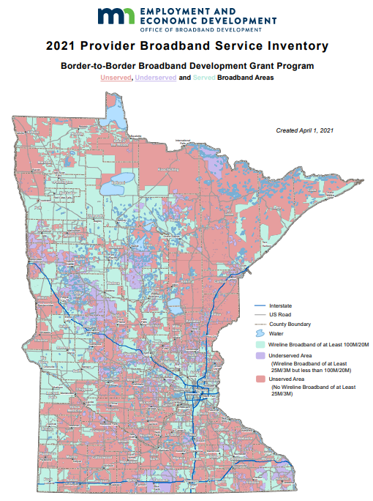
Progress…but not done yet
State Statutory
Broadband Goals:
All Homes and Businesses will have access to broadband service of at least:
25 Mbps download by 3 Mbps upload (Current FCC definition) by 2022
100 Mbps download by 20 Mbps upload by 2026
140,000 households without access to 25/3 (2022 goal)
231,000 without access to 100/20 (2026 goal)

Slide 5
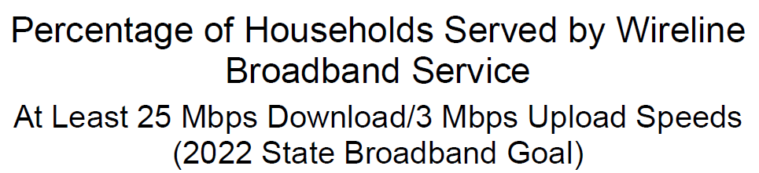
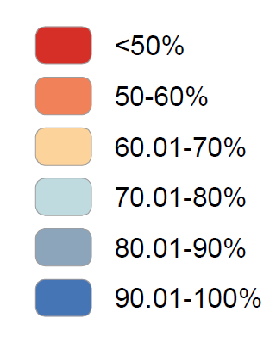


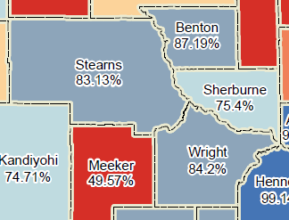
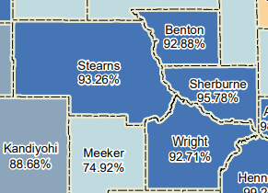

Slide 6
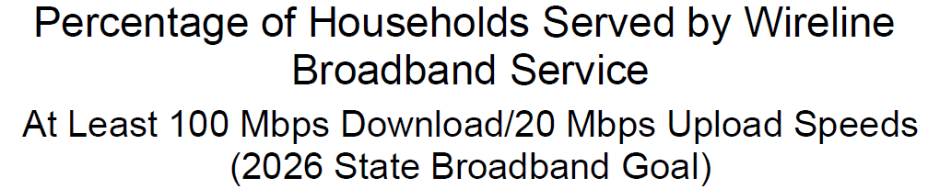
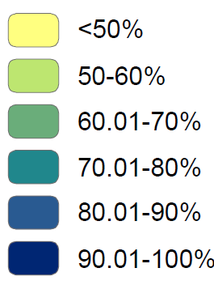


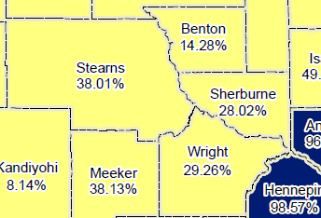
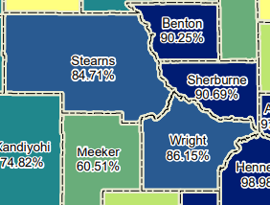

Slide 7
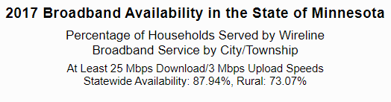
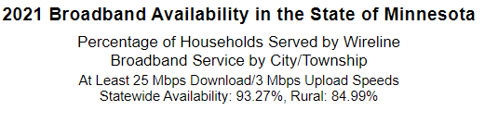
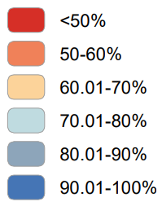
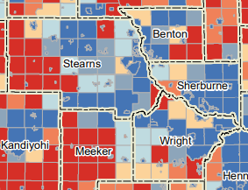
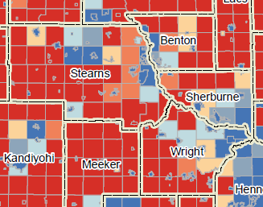

Slide 8
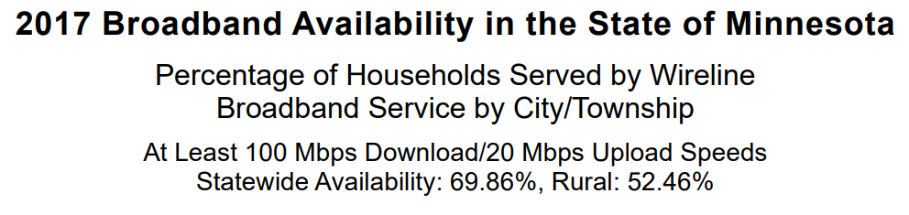
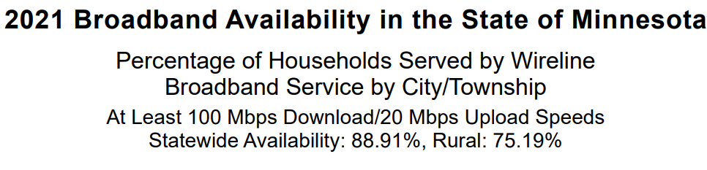
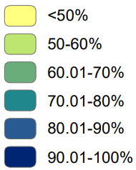
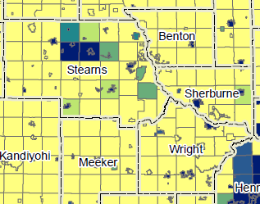
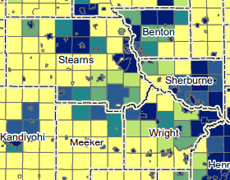

Slide 9

Broadband Grant Program
Since 2014, the Border-to-Border Broadband Development Grant program has provided broadband access to over 56,800 homes and businesses in unserved and underserved areas.
Notes:
Since 2014, the Border-to-Border Broadband Development Grant program has provided broadband access to over 56,800 homes and businesses in unserved and underserved parts of the state.

Slide 10
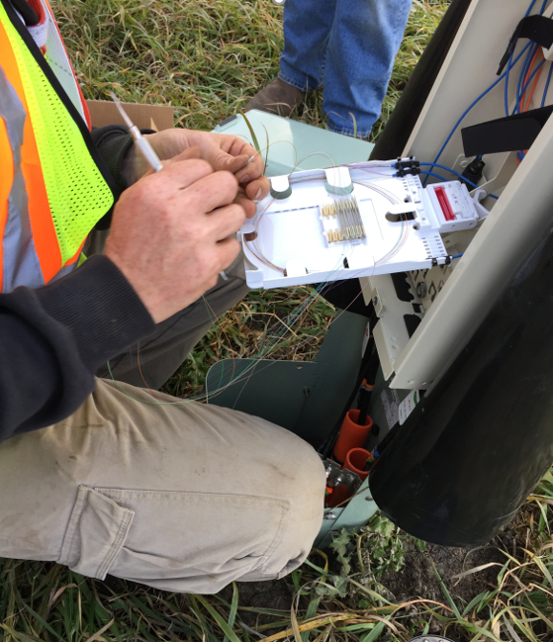
MN Border to Border Broadband Development Grant
Grant purpose: To provide financial assistance for the acquisition and installation of middle-mile and last-mile broadband infrastructure to areas of the state that do not have wireline access at federal and state minimum standard speeds.
Allowable costs: Examples of allowable costs: final project design; obtaining construction permits; purchase and/or construction of facilities, including construction of both “middle mile” and “last mile” infrastructure; and installation and testing of the equipment used to provide broadband service.

Slide 11
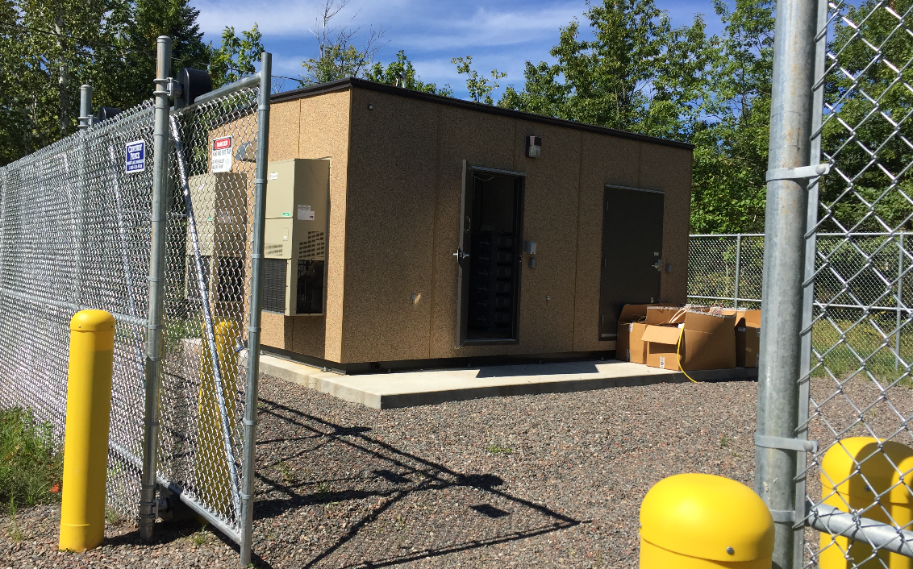
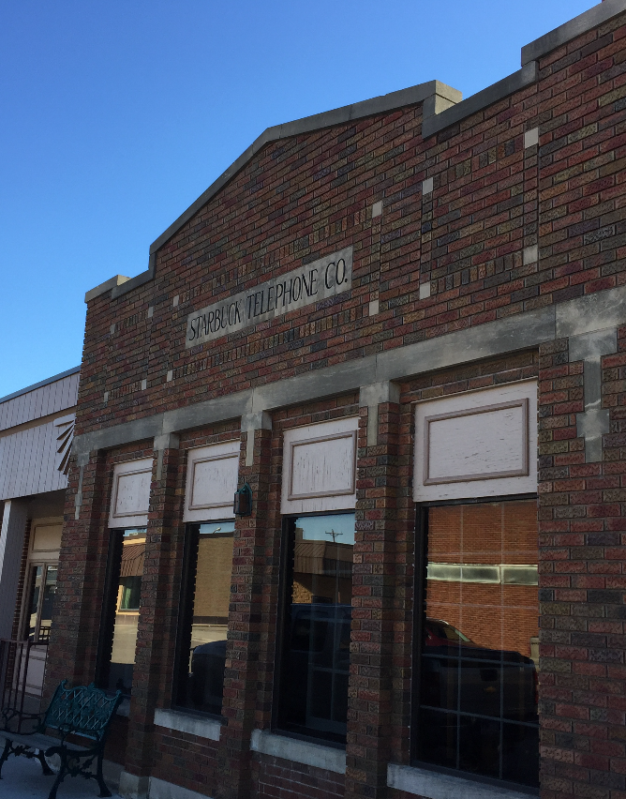
Border to Border Broadband Development Grant – Overview - Eligibility
Who is eligible to apply?
An incorporated business or partnership
A political subdivision
An Indian tribe
A Minnesota nonprofit organized under 317A
A Minnesota cooperative organized under 308A or 308B
A Minnesota limited liability corporation organized under 322C for the purpose of expanding broadband access

Slide 12
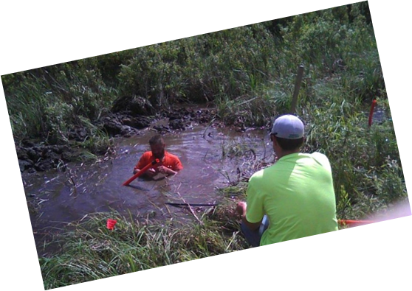
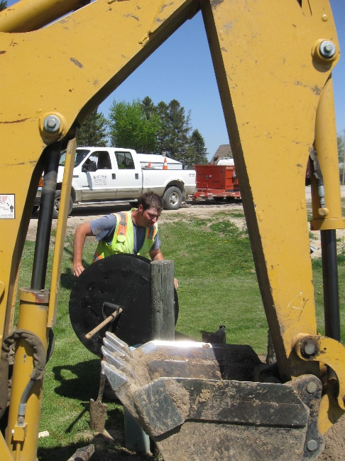
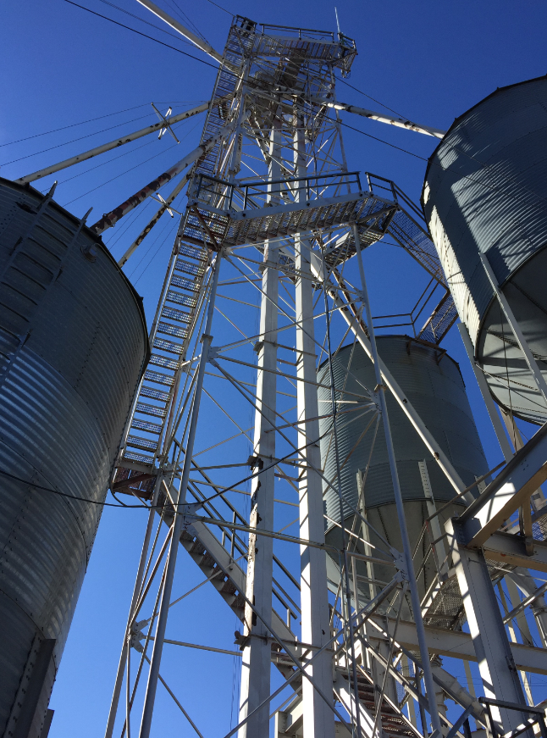
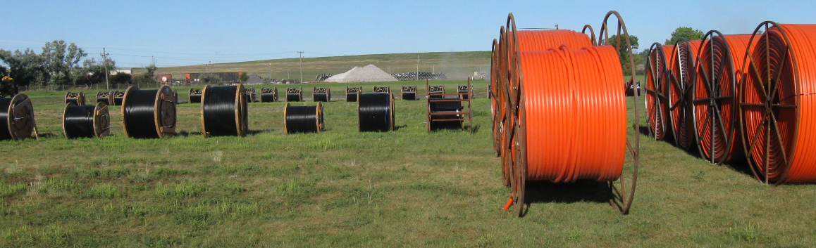
Border to Border Broadband Development Grant Overview—Prior Years
Annual general fund appropriations in 6 out of 7 years
Distributed in a single competitive grant round each FY funding received
Technology must be scalable to at least 100Mbps Up/Down
Cap of $5M per grant award
At least 1 to 1 match (50% of eligible expenses) required (More points awarded for higher match)
Grant awards are to be geographically dispersed
Speeds offered must achieve 25/3, most offer 100/20 or 1G
Notes:
Some highlights of the program here.

Slide 13
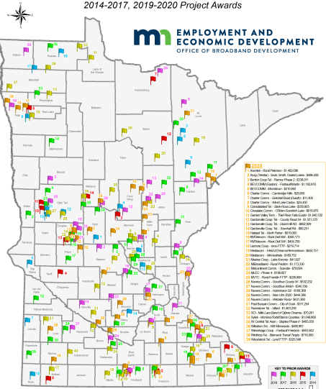
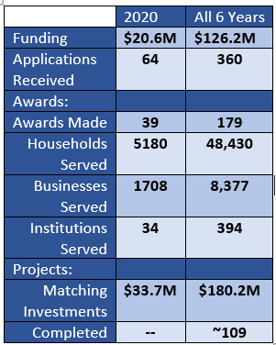
MN Border to Border Broadband Incentive Grants

Slide 14
Federal Funding Opportunities
USDA Community Connect—App window closed 12/23/20; unclear when next window opens
USDA ReConnect—Round 3 should open soon; approx. $600M
FCC Rural Digital Opportunity Fund (RDOF)—FCC reviewing long form apps; a handful approved
Consolidated Appropriations Act (passed December 2020):
NTIA Broadband Expansion to Underserved Communities ($288M) –Applications were due August 17; $2.5B in requests
NTIA Tribal Connectivity ($1B)—Applications were due September 1; $5B in requests
FCC Emergency Broadband Benefit ($3.2B)—Eligible household enrollment continues

Slide 15
Federal Funding Opportunities-cont.
American Rescue Plan Act or ARPA (passed March 2021)
State and Local Fiscal Recovery Funds
Broadband is an allowed use
Some local governments are funding broadband projects
State fiscal recovery funds-to date, none allocated for broadband in MN
Sec. 604 Capital Projects Fund
Minnesota’s allocation is $180,702,620 – awaiting further Treasury guidance – includes the $70M for the Border to Border grant program
Infrastructure Investment and Jobs Act (Passed Senate, Pending in House)
Possible add’l funding for infrastructure and digital equity programs

Slide 16
Questions?
Link to interactive map: Minnesota Map
Link to training on how to use interactive map: Recording
DEED Office of Broadband Development website: Office of Broadband Development / Minnesota Department of Employment and Economic Development (mn.gov)
Contact information:
Deed.broadband@state.mn.us
651-259-7610
Thank you!

