Slide 1
Welcome to today’s Broadband Leadership Webinar:
Federal and State Broadband Finance Programs
Thank you for joining us today!
When you join, your audio is muted and video disabled.
Move your cursor to the top or bottom of the screen to access the controls.
We recommend:
  Enable video if your internet connection allows; alternatively you can upload a photo.
  Keep your audio muted unless you have a reason to speak.
  Show the chat box - use it for non-time-sensitive questions and comments.
  Feel free to experiment with the controls! You won’t affect other people’s view.

Slide 2
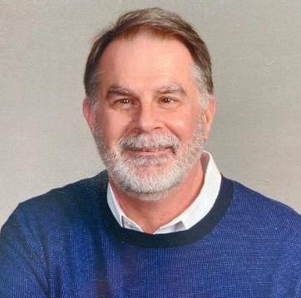
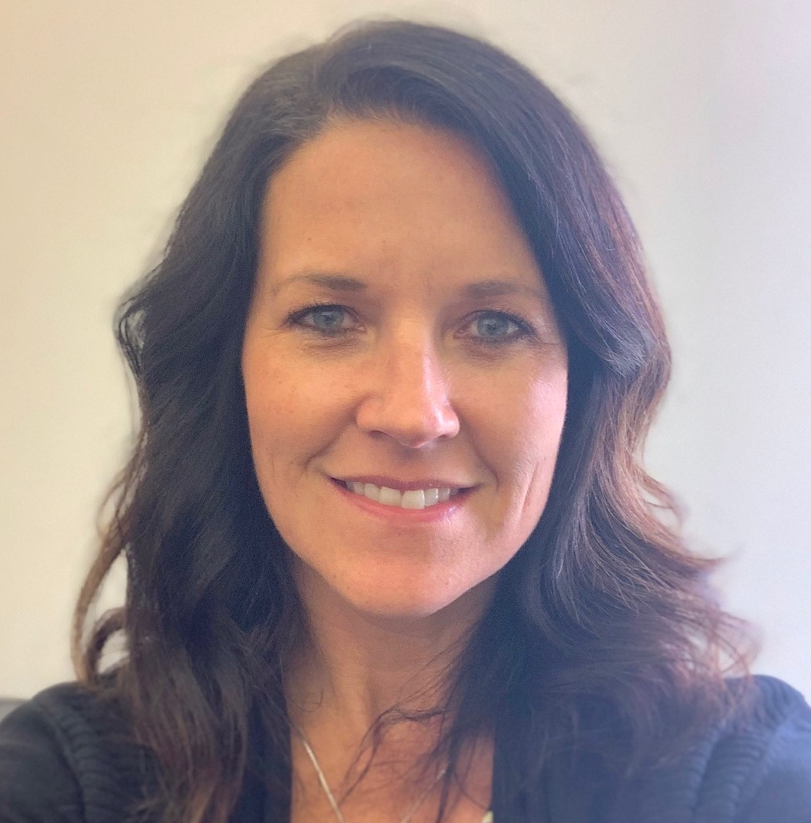

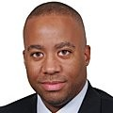
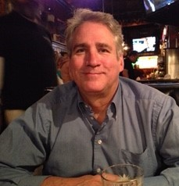
Broadband Leadership Webinar Series
Federal and State Broadband Finance Programs
Jim Beattie, BevComm
Stacy Cluff, Mille Lacs Energy Cooperative
Angie Dickison, MN Office of Broadband Development
Scott Woods, US Dept of Commerce, National Telecommunication and Information Agency (NTIA)
Bill Coleman, Community Technology Advisors

Slide 3
Broadband Development Process – Simplified!
Poor Broadband
Great Broadband
Notes:
If only achieving broadband improvements were this simple! Like flipping a switch – click! Unfortunately, as Bernadine said, if you are participating in this webinar, you understand that can be a very difficult path towards ensuring that your community has broadband infrastructure and services that, at a minimum, meets state broadband goals and ideally positions your community for growth.

Slide 4
Notes:
This table BEGINS to demonstrate the depth and complexity of the community broadband development process. I know that some of you have been working on this process for several years. If you were to map your efforts, there would be many more arrows on this page, most pointing back towards the beginning, engaging multiple times with incumbent and prospective providers as well as repeated efforts to engage local elected leadership.
In addition, some community efforts begin someplace in the middle of the chart and circle back towards the first and second columns.
Other communities, with better luck, managed to skip many of these steps due to quality private sector partners or extraordinary local elected officials. Some with little struggle have moved almost directly to the Celebrate phase! Lucky them!

Slide 5
Federal and State Broadband Finance Programs
An overview of existing and emerging broadband finance programs.

Slide 6
Join us Tuesdays and Thursdays at 9:00 am for the
Broadband Leadership Webinar Series: Creating Successful Broadband Infrastructure Projects
For more information, visit www.broadband.blandinfoundation.org and click the “webinars” banner.

