Slide 1
BroadbandUSA and the Broadband Opportunity Council
A webinar for the Blandin Foundation Community Broadband Program
Presented by Laura Breeden, June 18, 2015

Slide 2
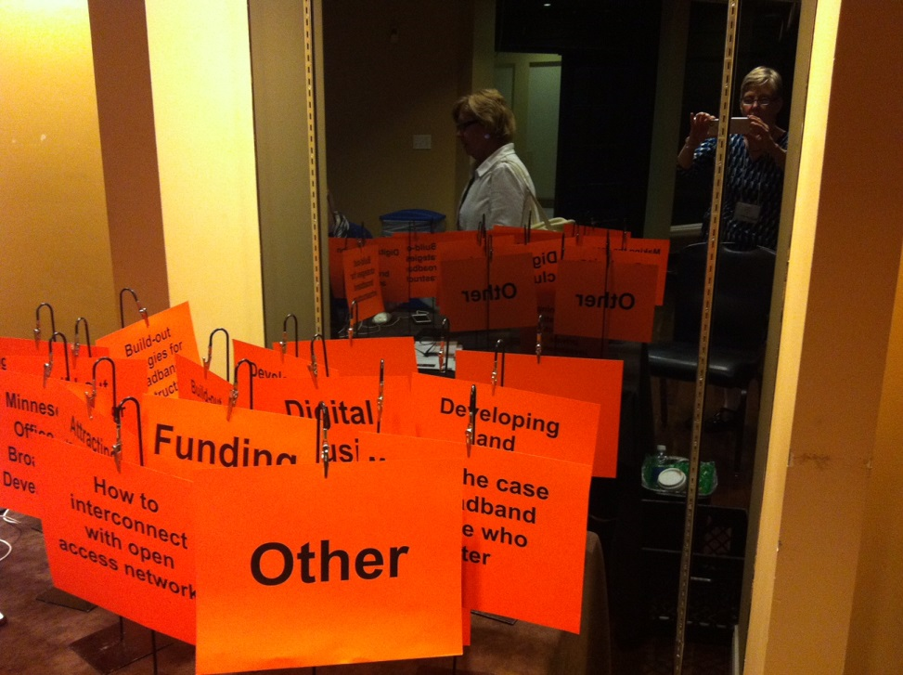

We’ve been to Minnesota!

Slide 3
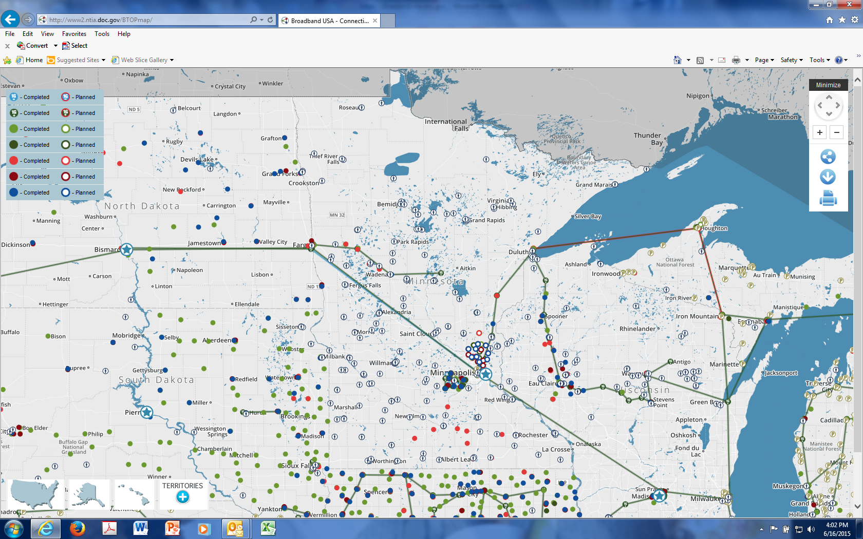
BTOP investments in Minnesota
Explore the Connecting America’s Communities map at http://www2.ntia.doc.gov/BTOPmap/

Slide 4
In January 2015, NTIA launched BroadbandUSA, a new initiative to build the momentum for broadband
Aims to promote broadband investment, deployment and adoption by building on the expertise gained through BTOP
Will assist local communities by:
Hosting regional conferences nationwide to convene stakeholders, ideas and solutions;
Offering online and in-person technical assistance for the planning and execution of broadband programs;
Distributing toolkits, guides and other resources on broadband infrastructure planning, financing, construction and operations

Slide 5
A quarter of Americans, about 78 million people, still do not have broadband at home
Industries across America rely on broadband to help them advance their missions
Broadband applications are vital to rural communities (Education, Small Business, Telehealth, Economic Development)
Folks around the nation want these broadband networks. They’re good for business. They’re good for communities. They're good for schools. And they’re good for the marketplace because they promote efficiency and competition.
- President Barack Obama, January 14, 2015

Slide 6
Data shows the clear impacts of investment in broadband infrastructure and adoption programs
Increased levels of employment: A 1 percent increase in broadband availability increases employment by 0.2 to 0.3 percent per year
Increased wages: Workers who upgrade their technology skills see average wage increases of $111 per month. Individuals who use the Internet at home and work make $1.40 more per hour than non-users
Increased social, health and educational benefits: By accessing health information online, 35 percent of new broadband users saved $217 per year on healthcare expenses

Slide 7
The new initiative builds on NTIA’s expertise to support communities with broadband investment
Provides assistance to communities that want to improve their broadband capacity and use broadband more effectively
Offers expert, impartial advice and field-proven tools for assessing broadband adoption, planning new infrastructure, and engaging a wide range of partners in broadband projects
Brings stakeholders together to solve problems, contribute to emerging policies, and link communities to other federal agencies and funding sources

Slide 8

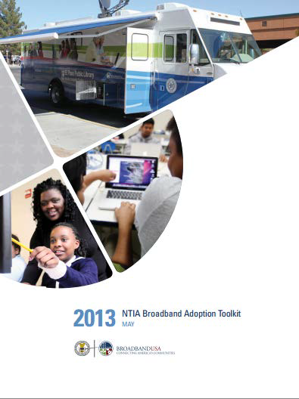

NTIA will offer technical assistance to help guide recipients as they take on broadband efforts
Offer one-to-one Technical Assistance
Publish toolkits and documents that leverage best practices and lessons learned from BTOP and SBI

Slide 9

BroadbandUSA will also engage communities through external outreach activities
Establish and maintain relationships with stakeholders
Convene events and workshops
Communicate via BroadbandUSA site, social media and email listserv
Deliver webinars to provide timely and focused information
Support regional networks

Slide 10

NTIA will establish interagency partnerships to encourage broadband investment and adoption
Promote broadband through coordination and education with federal agency colleagues
NTIA and partner agencies will identify and address policy barriers
Broadband Opportunity Council efforts are also paving the way for interagency coordination to support community broadband efforts

Slide 11



NTIA staff are available to provide assistance with a current or planned broadband project
(202) 482-2048
www2.ntia.doc.gov
BroadbandUSA@ntia.doc.gov

Slide 12
The following resources provide more information on BroadbandUSA and related broadband efforts
NTIA Broadband Adoption Toolkit
http://www2.ntia.doc.gov/toolkit
BTOP Economic & Social Impact Study
http://www.ntia.doc.gov/report/2015/asr-analytics-reports-and-case-studies
NTIA Public-Private Partnership Guide
http://www2.ntia.doc.gov/files/ntia_ppp_010515.pdf

Slide 13
The Broadband Opportunity Council
.

Slide 14
In March 2015, President Obama established the Broadband Opportunity Council (BOC)
“Access to high-speed broadband is no longer a luxury; it is a necessity for American families, businesses, and consumers.”
“The Federal Government has an important role to play in developing coordinated policies to promote broadband deployment and adoption, including promoting best practices, breaking down regulatory barriers, and encouraging further investment. Doing so will help deliver higher quality, lower cost broadband to more families, businesses, and communities and allow communities to benefit fully from those investments.”

Slide 15
The BOC’s goal is to improve federal coordination of broadband policies and actions
The BOC aims to coordinate federal policies to promote broadband deployment, competition and adoption by:
Addressing regulatory barriers
Encouraging public and private investment
Promoting broadband adoption and meaningful use
The Council’s activities include:
Surveying federal agencies about broadband programs and regulations
Gathering action recommendations from agencies
Submitting a final action agenda to the President in August

Slide 16
The BOC includes more than 25 Federal government agencies and components
Co-Chairs
Commerce (NTIA) |  | Agriculture (Rural Development)
Members
Defense State Interior Labor Health and Human Services Housing and Urban Development Homeland Security Justice Transportation | Treasury Education Veterans Affairs Environmental Protection Agency General Services Administration Small Business Administration Institute of Museum and Library Sciences |  | Office of Management and Budget National Science Foundation Council on Environmental Quality Office of Science and Technology Policy Council of Economic Advisors Domestic Policy Council National Economic Council National Security Council

Slide 17




BOC members are working together to promote broadband deployment and adoption
Engage with industry and other stakeholders to understand how the government can better support the needs of communities seeking to improve broadband investment
Survey existing programs that currently support or could be modified to support broadband competition, deployment or adoption
Identify regulatory barriers that impede broadband deployment or competition
Take necessary actions to remove these barriers and re-align existing programs to increase broadband competition, deployment and adoption

Slide 18
Member agencies responded to a comprehensive survey on broadband policy and programs
Each Agency provided information on:
Programs that currently support broadband adoption and deployment
Programs that could reasonably be modified to support broadband adoption and deployment
Agency-specific policies and rules that directly or indirectly facilitate or regulate the investment in or deployment of broadband networks
Information is intended to reduce regulatory barriers and to encourage and support broadband deployment, competition and adoption

Slide 19
The BOC also released a Request for Comment from public broadband stakeholders
The RFC aimed to:
Gather a broad range of stakeholder input
Get firsthand feedback about current issues and opportunities
Identify key constituencies and stakeholders
Solicit bold new ideas
All comments are public at http://www.ntia.doc.gov/federal-register-notice/2015/broadband-opportunity-council-comments
Comments will be used in drafting the final report to the President

Slide 20
In August 2015, the BOC will recommend steps to remove investment and adoption barriers
The report to the President will:
Incorporate feedback from the federal agency survey and the public Request for Comments
Offer a prioritized list of recommendations on actions that agencies can take to support broadband deployment, adoption and competitoin
Include a list of priority actions and rulemakings, as well as timelines to complete them

Slide 21
White House Broadband Summit
Likely to be held July 2015
Will include municipalities and others working to improve broadband deployment, adoption and competition
USIgnite program is spearheading (http://www.us-ignite.org/)

Slide 22
For more information on the BOC and its activities, please use the following resources
Presidential Memo on BOC
https://www.whitehouse.gov/the-press-office/2015/03/23/presidential-memorandum-expanding-broadband-deployment-and-adoption-addr
White House “Broadband That Works” Fact Sheet
http://www.whitehouse.gov/the-press-office/2015/01/13/fact-sheet-broadband-works-promoting-competition-local-choice-next-gener
Request for Comment Federal Register Notice http://www.ntia.doc.gov/files/ntia/publications/fr_boc_notice_and_rfc_4-29-15.pdf

Slide 23
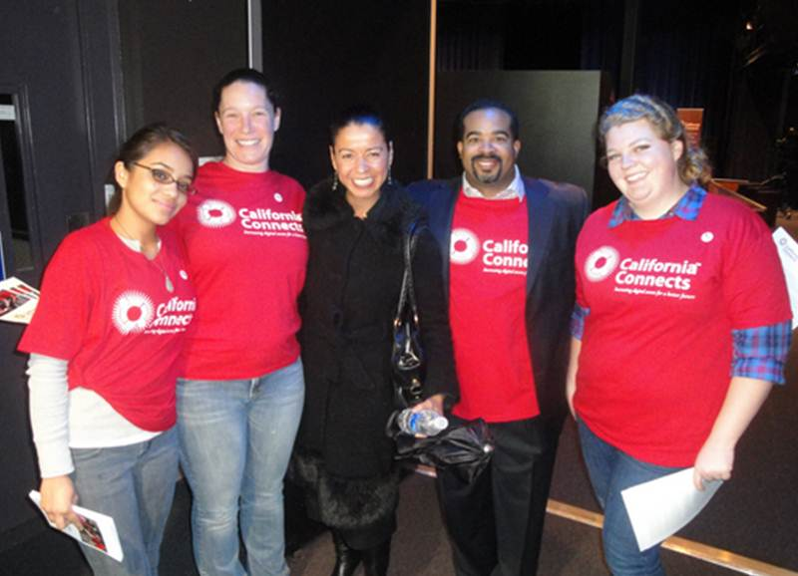
Thank you!
For more information, email broadbandusa@ntia.doc.gov
Or visit the web site, at http://www2.ntia.doc.gov

