Slide 1
Update on Dakota County Data Networks Planning
Board of Commissioners
April 21, 2015

Slide 2

2015 Capital Improvement Program
Expand and upgrade the County fiber network
  Connect County facilities and increase data capacity
  Address known deficiencies and assures stability and redundancy
  Support essential County business needs
Principles for prioritizing and recommending projects
  Publicly owned network for core business functions
  Cost-sharing through regional collaboration
  “Dig once” and reduce costs by installing fiber during planned construction
Data Networks Planning - Overview

Slide 3
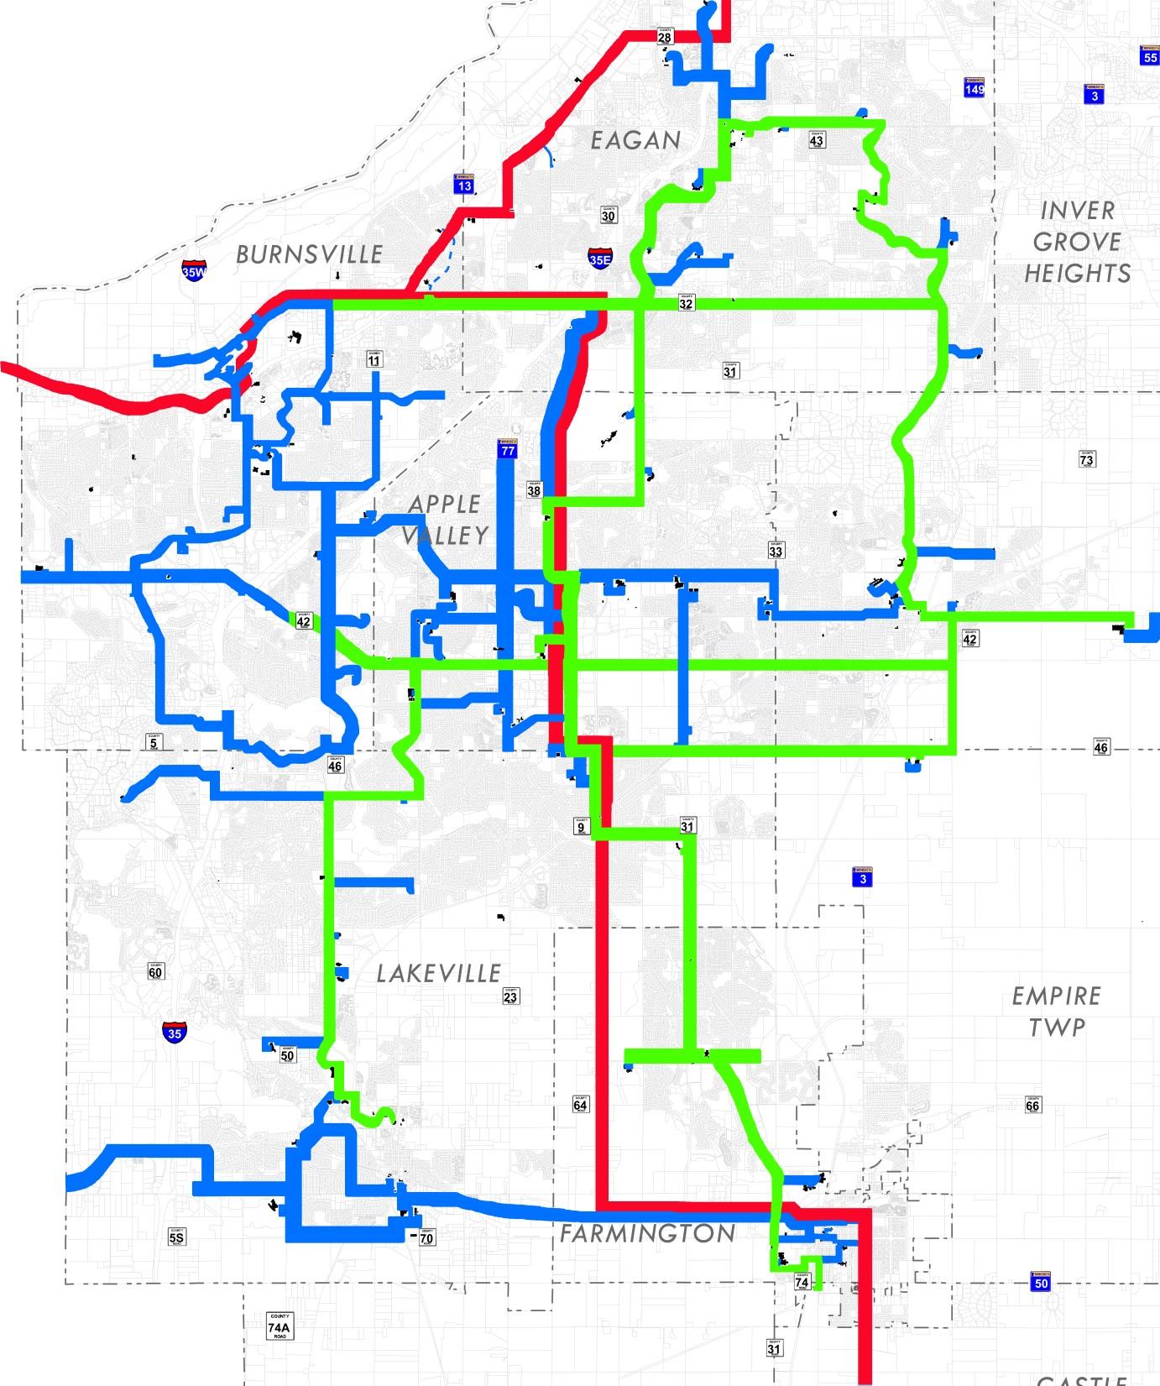

Slide 4
Project # | Project Name | County Business Need | Other Partners | Miles
3 | Wentworth Library | Connect library to DC network | Wentworth Library | 1
5 | DCTC to CR 3 | Upgrade DCTC fiber network | DCTC | 3.1
7 | CR 42 Traffic Signals | Upgrade fiber network during signal reconstruction project | State of MN; Cities of Burnsville, Apple Valley and Rosemount | 8
8 | Robert Street | Connect network to Ramsey County and improve DC backbone network | State of MN; City of West St. Paul; Ramey County | 4
9 | County-wide Traffic Signals | Improve traffic signalization | Transportation Dept | 2.4
12 | Apple Valley | Upgrade DC network and improve traffic signalization | City of Apple Valley | 6.2
13 | Burnsville | Upgrade DC network and improve traffic signalization | City of Burnsville | 1.8
14 | Farmington | Upgrade DC network and improve traffic signalization | City of Farmington | 10
Data Networks Planning – Planned Projects

Slide 5
Project # | Project Name | County Business Need | Other Partners | Miles
17 | Lebanon Hills Center | Connect visitor center to DC fiber network | DC Parks Dept | 5
18 | Eagan: Lone Oak | Connect traffic signals and improve DC fiber network | City of Eagan | 10.8
19 | Spring Lake Park: Byllesby Dam | Connect dam and park to DC network to improve services | State of MN; Goodhue County; City of Cannon Falls | 10.3
20 | Fiber Expansion: Empire | Upgrade DC network and improve traffic signalization |  | 3
22 | Lakeville | Connect traffic signals and improve DC fiber network | State of MN; City of Lakeville | 7.8
23 | Whitetail Woods | Connect park facilities to DC fiber network | State of MN; U of M | 5.4
27 | Dakota Lodge | Connect Lodge, Inver Glen Library to DC fiber network | DC Libraries and Parks Dept | 1.4
9 | CR 32 Traffic Signals | Upgrade DC network and improve traffic signalization | Transportation Dept | 3.1
Data Networks Planning – Planned Projects

Slide 6
CR 42 Traffic Signals
Partner with the state of Minnesota, the cities of Burnsville, Apple Valley, Rosemount and ISD #196 during the signal reconstruction project along CR 42
  Use the “Dig Once” policy to install additional fiber strands during construction
  Connect traffic signals to the County network to improve signal times and traffic flow.
Data Networks Planning – Project Highlights

Slide 7
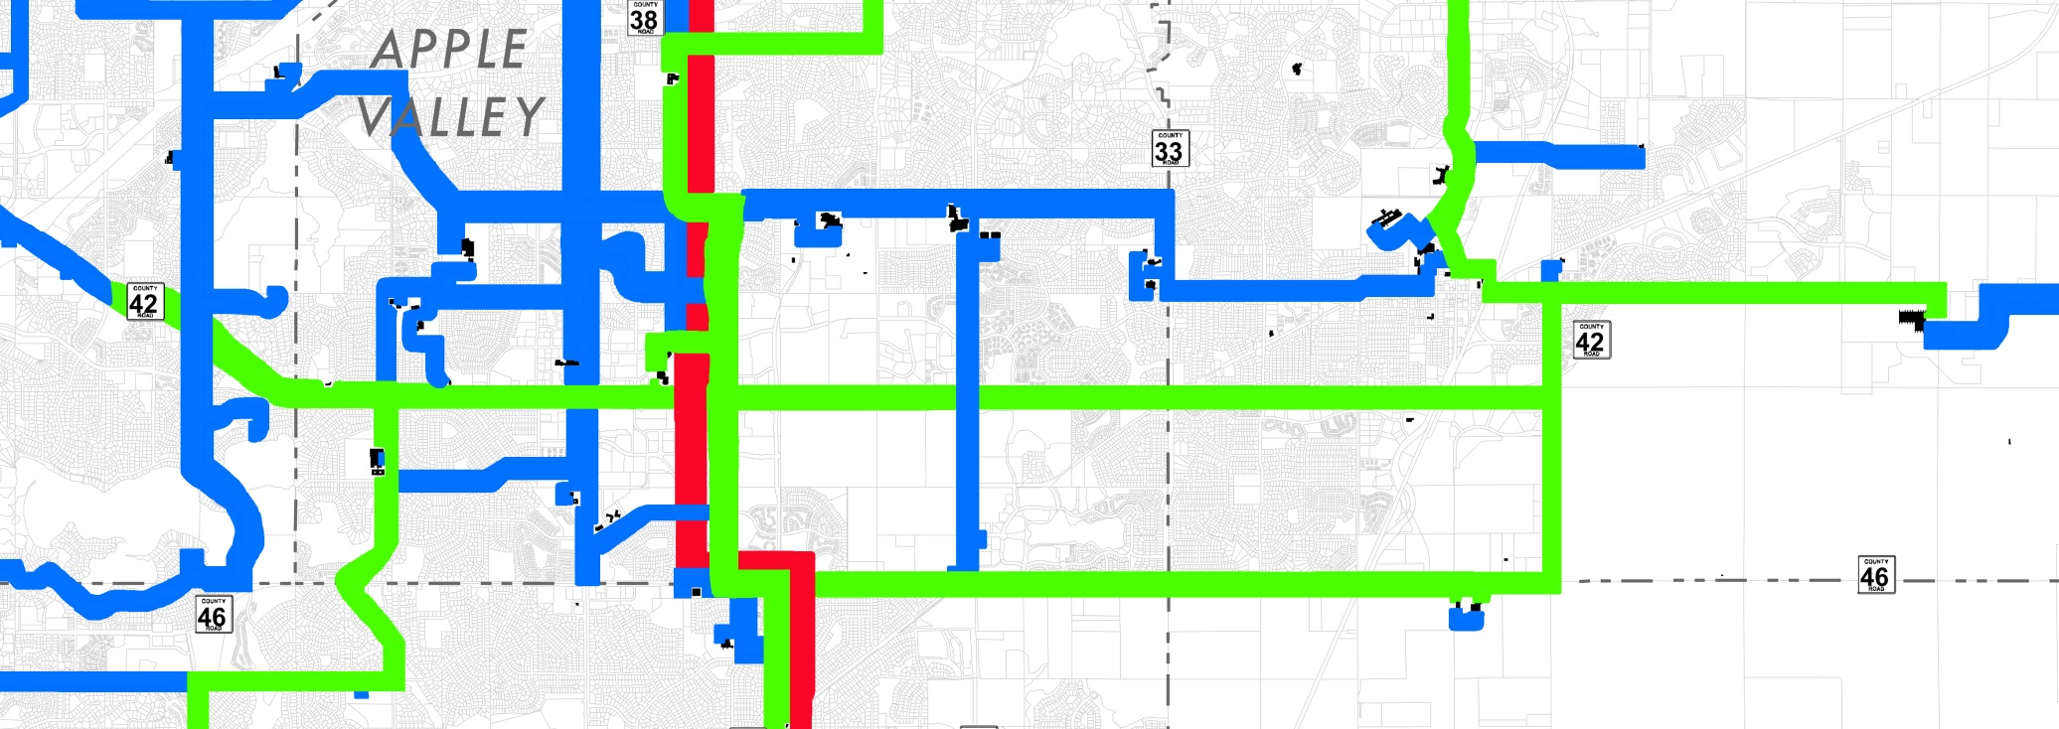

Slide 8
Robert Street Construction
Collaboration with the State and the City of West St. Paul to install fiber as part of the Robert Street project
  Provides a High-density Communications Corridor connecting Dakota County to Ramsey County and State networks
  Connects multiple County facilities on route
  “Dig once” policy reduces cost of installation
Data Networks Planning – Project Highlights

Slide 9
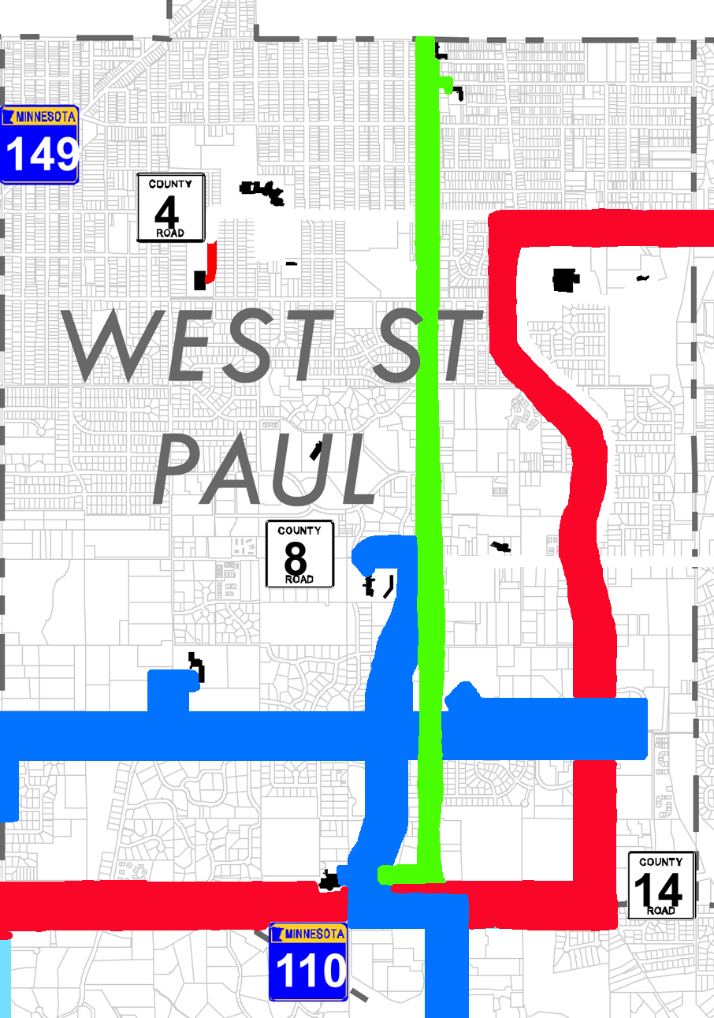

Slide 10
Farmington
Partner with the City of Farmington to upgrade the County’s fiber infrastructure
  “Dig once”: upgrades to occur during the CR 64 reconstruction
  Connects traffic signals to improve timing and traffic flow
  Adds redundancy and capacity to the County network
  Future opportunity for Farmington Industrial Park connection
Data Networks Planning – Project Highlights

Slide 11
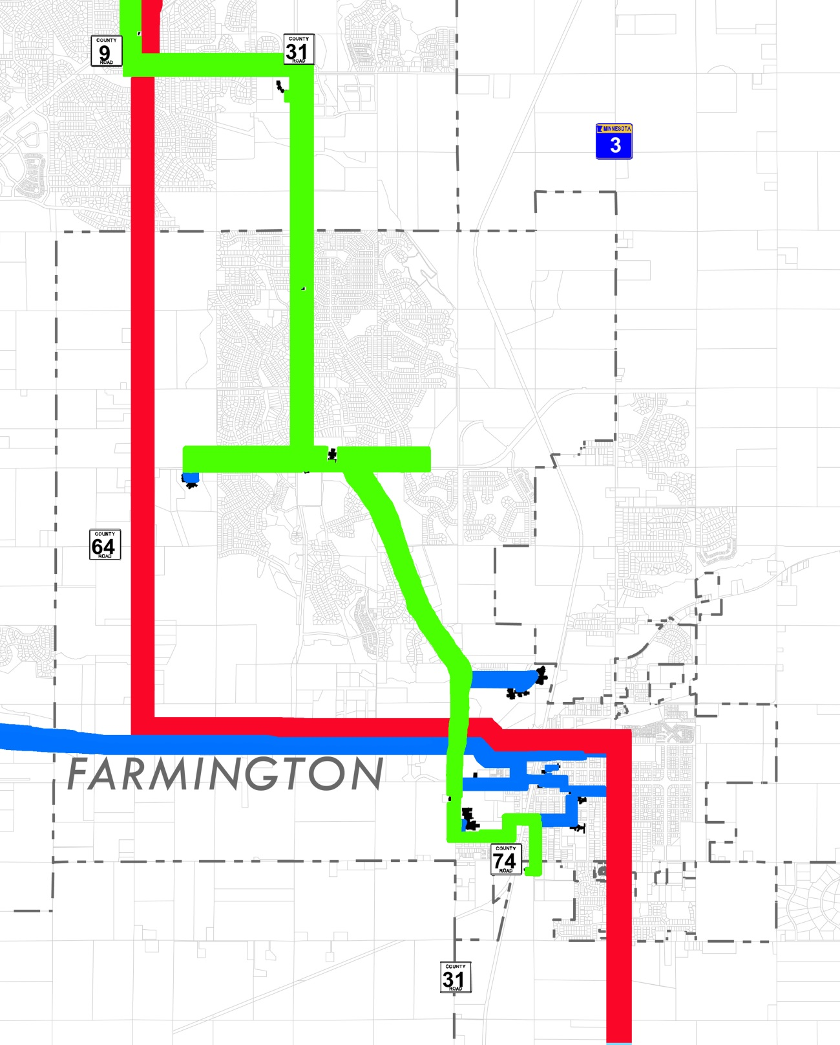

Slide 12
Agreements and Partnerships
State of Minnesota network
  Redundancy
  Maintenance
Metro County collaboration
  Cost sharing
  Empower collaboration
DC cities, County, CDA potential JPA for I-Net
  Scale advantages from cooperative management
  Foundation for future efforts
Data Networks Planning - Collaboration

Slide 13
The Importance of a Fiber Backbone
More secure, faster and more efficient than cable
Greater lifespan and higher data capacity
Connections between county facilities allows for the sharing of software over the network
Multiple communication modes can be consolidated on the network, reducing costs
Share maintenance costs with public partners
Reduces number of internet provider connection points enhancing accessibility and redundancy
Centralized security and building management systems
Data Networks Planning - Collaboration

Slide 14
Looking Ahead
Developing a JPA for cooperative management of the Institutional Network across the county
Connecting the County’s 800 MHz radio towers
Connecting Farmington and Northfield
  Regional collaboration between the State, Rice County and the City of Northfield
Data Networks Planning - Collaboration

Slide 15
Request for Authorization
500,000 feet of fiber cabling, conduit and duct
$1.2 million total material cost
Purchasing vendor: Graybar
  Member of the US Communities Government Purchasing Alliance Program
  Technically superior quality at comparable rates
Bulk purchasing
  Cost of fiber materials expected to increase
  Purchasing in bulk reduces cost by 25%
Data Networks Planning - Purchasing

Slide 16
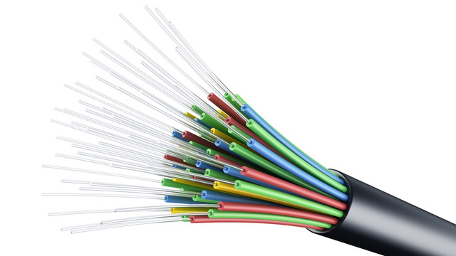
Questions or Comments

