Slide 1

Blandin Broadband Webinar April 10, 2014
Kevin T. Larson, CEO/GM
Consolidated Telecommunications Company (CTC)

Slide 2
What is 700 MHz
700 MHz spectrum was previously used for analog television broadcasting, specifically UHF Channels 52-69.
The 700 MHz band is divided into two categories – the lower 700 MHz band and the upper 700 MHz band. The lower band is 48 MHz while the upper band is 60 MHz.
In 2002, the FCC re-allocated the 698-746 MHz band (lower 700 MHz band) that was originally used by TV Channels 52-59.
The advantage of the 700 MHz spectrum is that the signals travel longer distances than the higher frequencies used by many other wireless systems. Networks using this spectrum require fewer cell towers to reach the same geographic area. In addition, like TV broadcasting, signals in this spectrum penetrate walls easily.
The disadvantage is the limited bandwidth available per channel.
Higher frequency bands offer greater capacity but the signal travels shorter distances with more difficulty penetrating walls.

Slide 3
CTC Spectrum-Owned
700 MHz – Lower Band – two “C” 6 MHz channels.
Counties – Isanti, Morrison, Mille Lacs, Kanabec, Pine, Lower Cass, Crow Wing, Aitkin, Carlton.
Currently used for fixed wireless broadband.
Equipment has limitations with limited bandwidth available to customers.
Currently testing new equipment – 4G LTE capabilities.
Significantly more bandwidth available for customers.
Current drawback – equipment is designed for 12 MHz channels.
AT&T owns 700 MHz – two “B” channels – over the top of CTC.

Slide 4
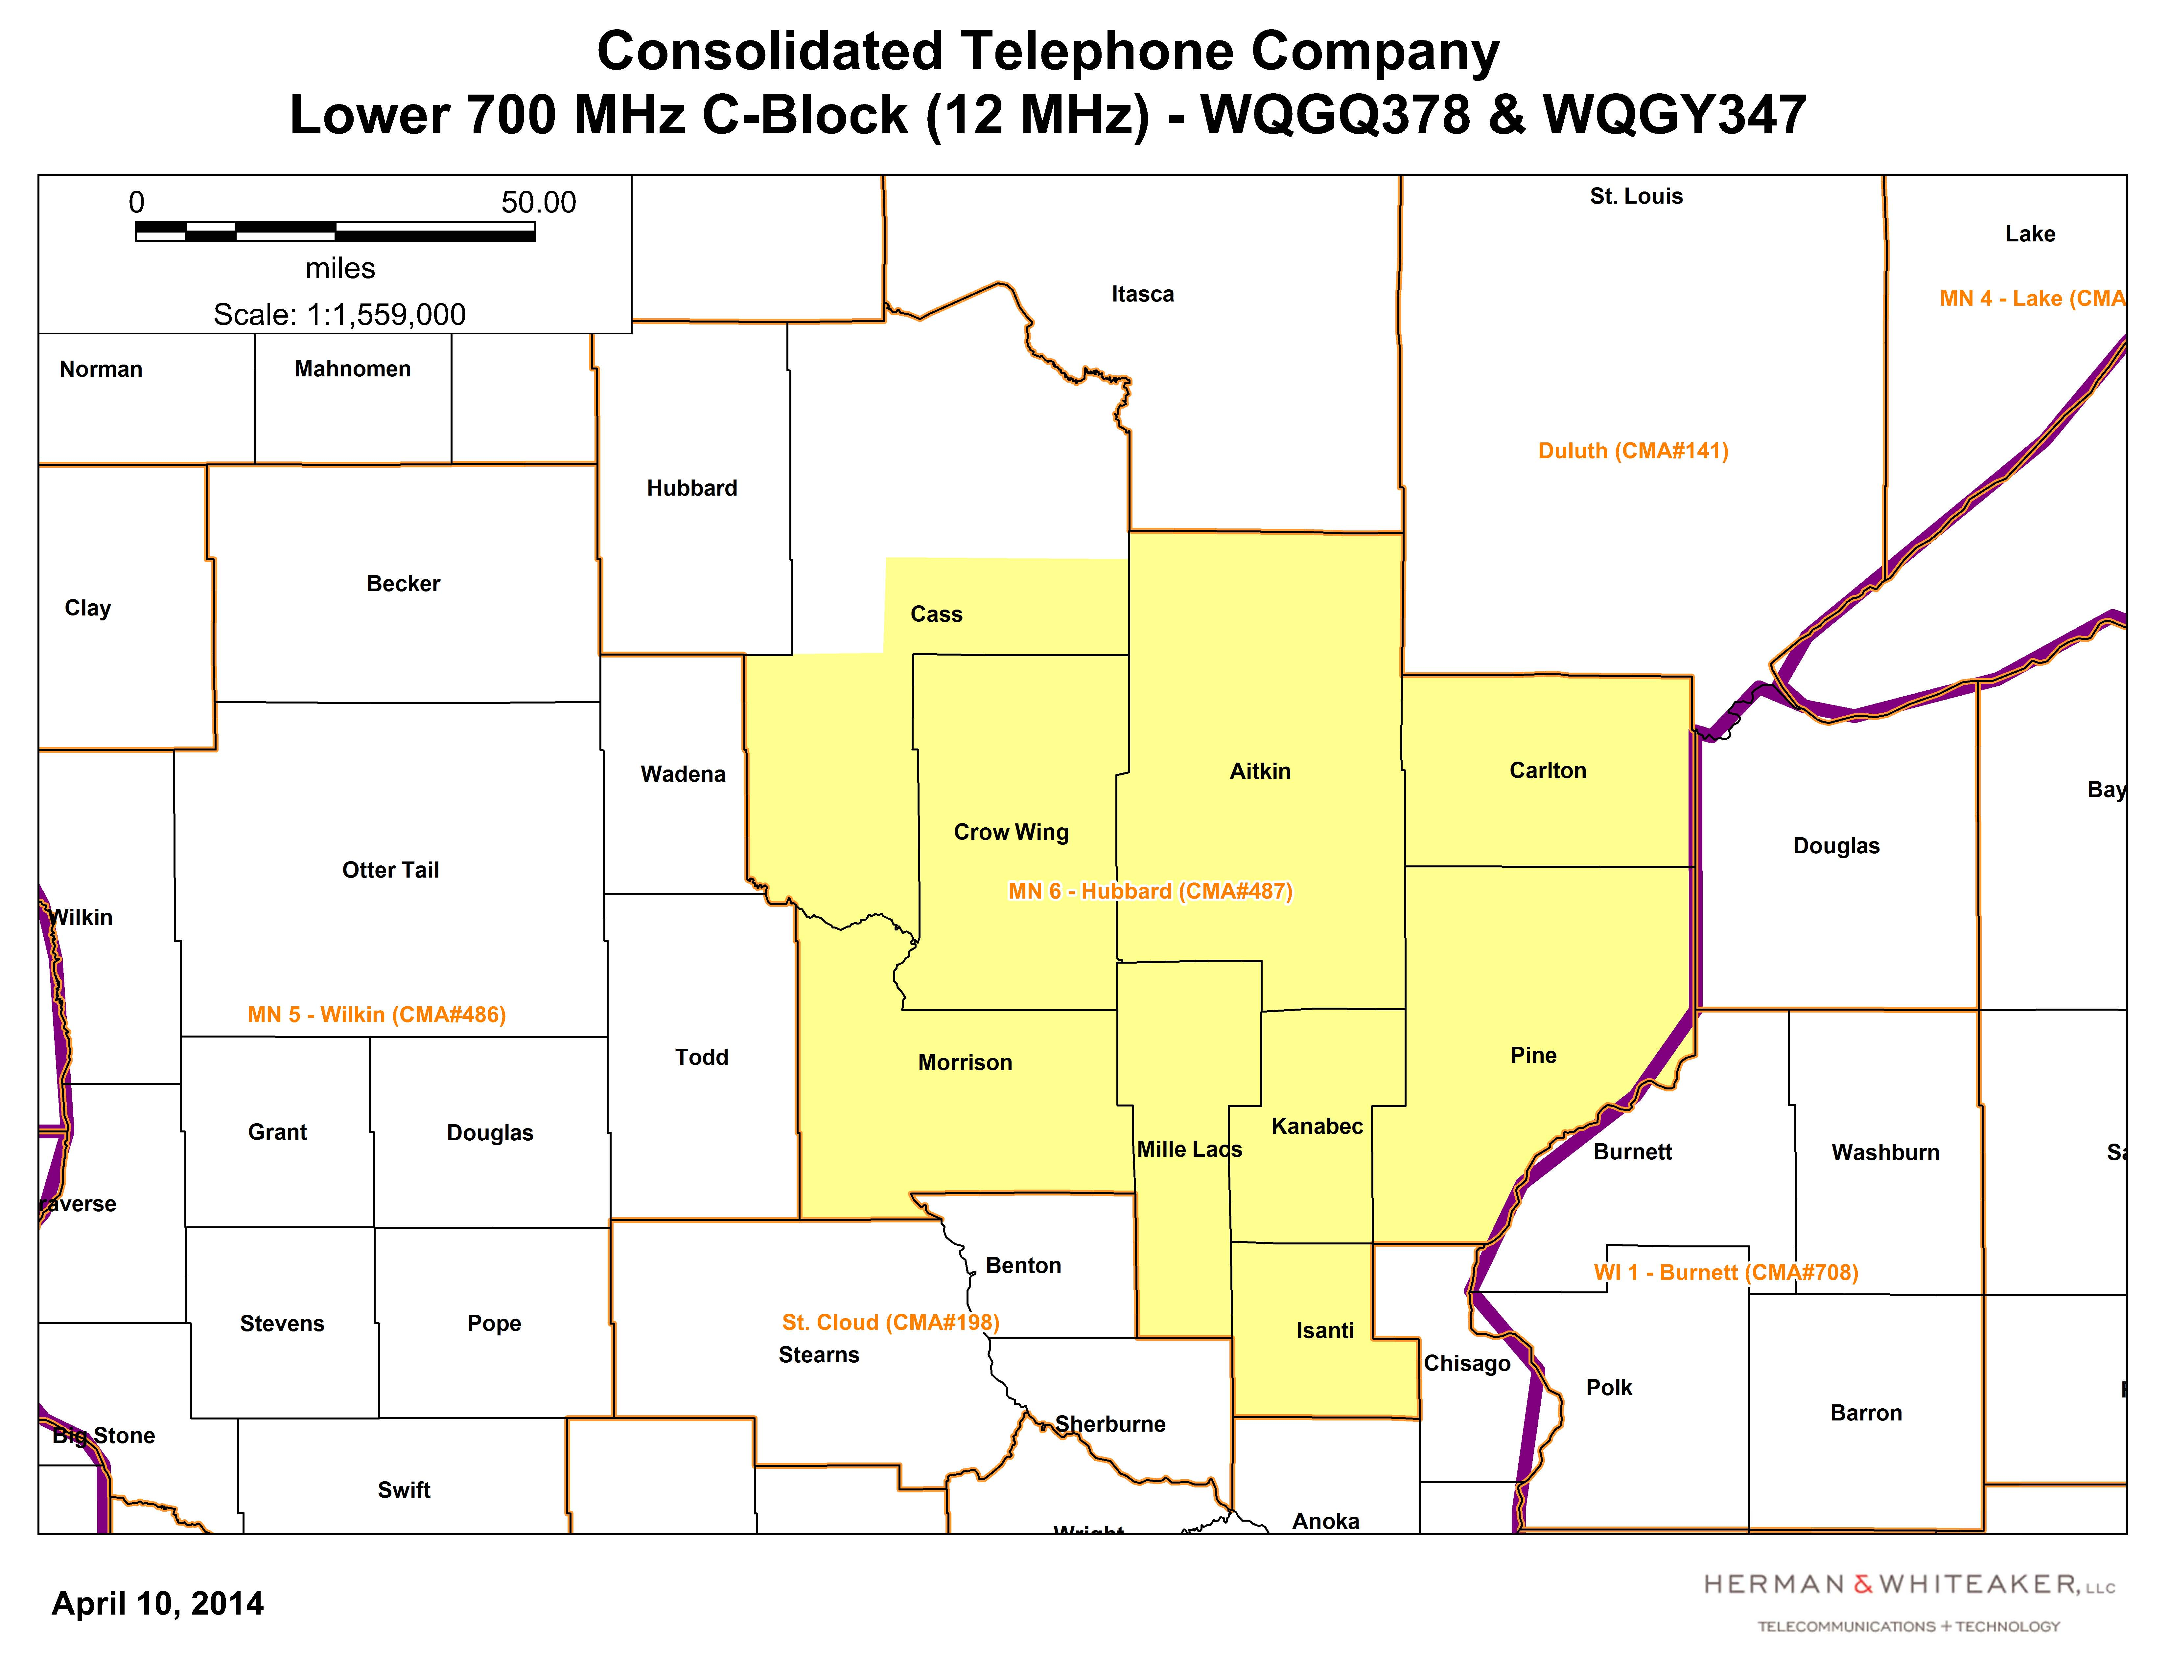

Slide 5
700 MHz Available
I am unaware of any available 700 spectrum.
Results from 2008 Auction - $19.6 billion in winning bids. Verizon and AT&T were the big winners. For $9.9 billion, Verizon won 109 licenses nationwide in the A, B, and C blocks; each C-block license covering a huge geographic area. AT&T won 227 B-block licenses for $6.6 billion.
Website for the FCC is http://wireless.FCC.gov/
600 MHz Incentive Auction projected to take place in 2015.

